Slide 1


Creating ML-based Self-learning IoT Devices
Bharath Sudharsan

Slide 2
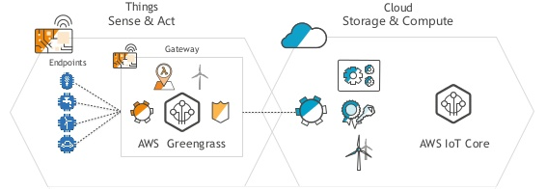
Introduction
A typical IoT scenario: Edge devices (Endpoints) depends on cloud for inference and model updates
For high inference accuracy, edge devices log unseen data in the cloud via the internet. Using this logged data, the initial model is re-trained and then sent as an over-the-air (OTA) update. In such online approaches,
The cost of edge devices increases due to wireless module addition, while also increasing the cyber-security risks and power consumption
Such online devices are not self-contained ubiquitous systems since they depend on the cloud services for inference and re-training
Notes:
http://aws-de-media.s3.amazonaws.com/images/AWS_Summit_2018/June6/Lowflyinghawk/Easier%20than%20Ever%20An%20Introduction%20for%20Building%20End%20to%20End%20IoT%20Solutions.pdf

Slide 3

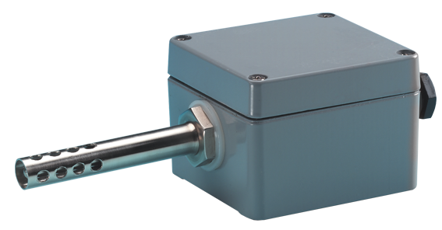
Introduction
Scene A
In the real-world, every new scene generates a fresh, unseen data pattern
When the model deployed in edge devices sees such fresh patterns, it will either not know how to react to that specific scenario or lead to false or less accurate results
A model trained using data from one context will not produce the expected results when deployed in another context
It is not feasible to train multiple models for multiple environments and contexts
Input
0 - 40 C
5 - 400 Lux
1.1 - 1.8 Bar
Mobile
edge device
Accuracy: 92 %
Scene B
Input
-10 - 1 C
1 - 10 Lux
2 - 4 Bar
Mobile
edge device
Accuracy: 54 %
An IoT edge device exposed to new scenes/environments

Slide 4

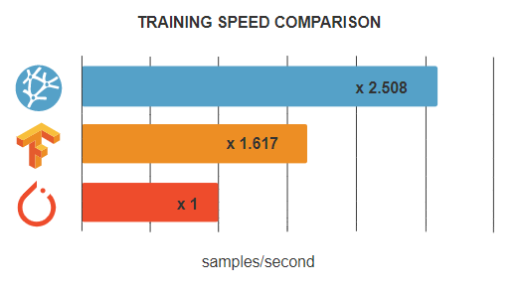

On Device ML Model Training
To enable the edge devices to learn offline after deployment, the ML model deployed and running on the edge devices need to be re-trained/updated offline and directly at the device level
OpenNN
Top ML Frameworks for running ML models on MCUs. It does not yet support training models on MCUs
ML frameworks like TensorFlow Micro, FeatherCNN, Open-NN, etc. do not yet enable training models directly on MCUs, small CPUs and FPGAs
Currently models are trained on GPUs then deployed on IoT edge devices after deep compression/optimization

Slide 5
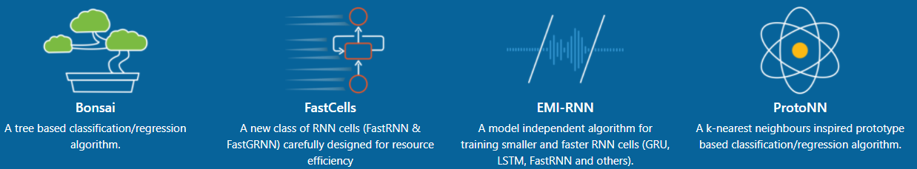
On Device ML Model Training
Microsoft EdgeML provides Algorithms and Tools to enable ML inference on the edge devices
Bonsai: non-linear tree-based classifier which is designed to solve traditional ML problem with 2KB sized models
EMI-RNN: speeding-up RNN inference up to 72x when compared to traditional implementations
FastRNN & FastGRNN: can be used instead of LSTM and GRU. 35x smaller and faster with size less than 10KB
SeeDot: floating-point to fixed-point quantization tool including a new language and compiler

Slide 6

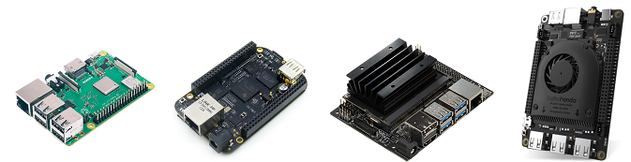
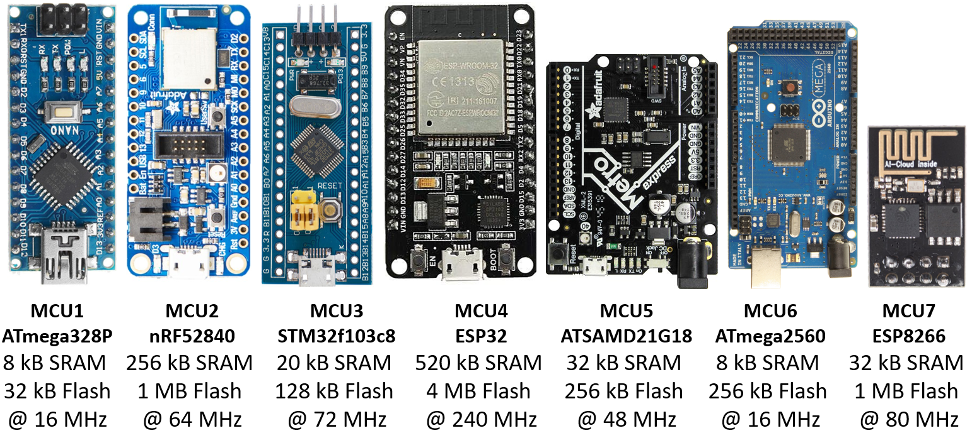
On Device ML Model Training
Powerful CPU + basic GPU based
SBCs (single board computers)
Numerous papers, libraries, algorithms, tools exists to enable self-learning and re-training of ML models on better resourced devices like SBCs
Due to ML framework support i.e., TF Lite can run on SBCs and not on MCUs
SEFR paper: Classification algorithm specifically designed to perform both training and testing on ultra-low power devices
ML in Embedded Sensor Systems paper: Enable real-time data analytics and continuous training and re-training of the ML algorithm
Billions of IoT devices are designed using such MCUs and small CPUs
Notes:
https://arxiv.org/pdf/2006.04620.pdf
https://ieeexplore.ieee.org/stamp/stamp.jsp?tp=&arnumber=7886051

Slide 7
Research Question
After real-world deployment, can the highly resource-constrained MCU-based IoT devices autonomously (offline) improve their intelligence by performing onboard re-training/updating (self-learning) of the local ML model using the live IoT use-case data?

Slide 8
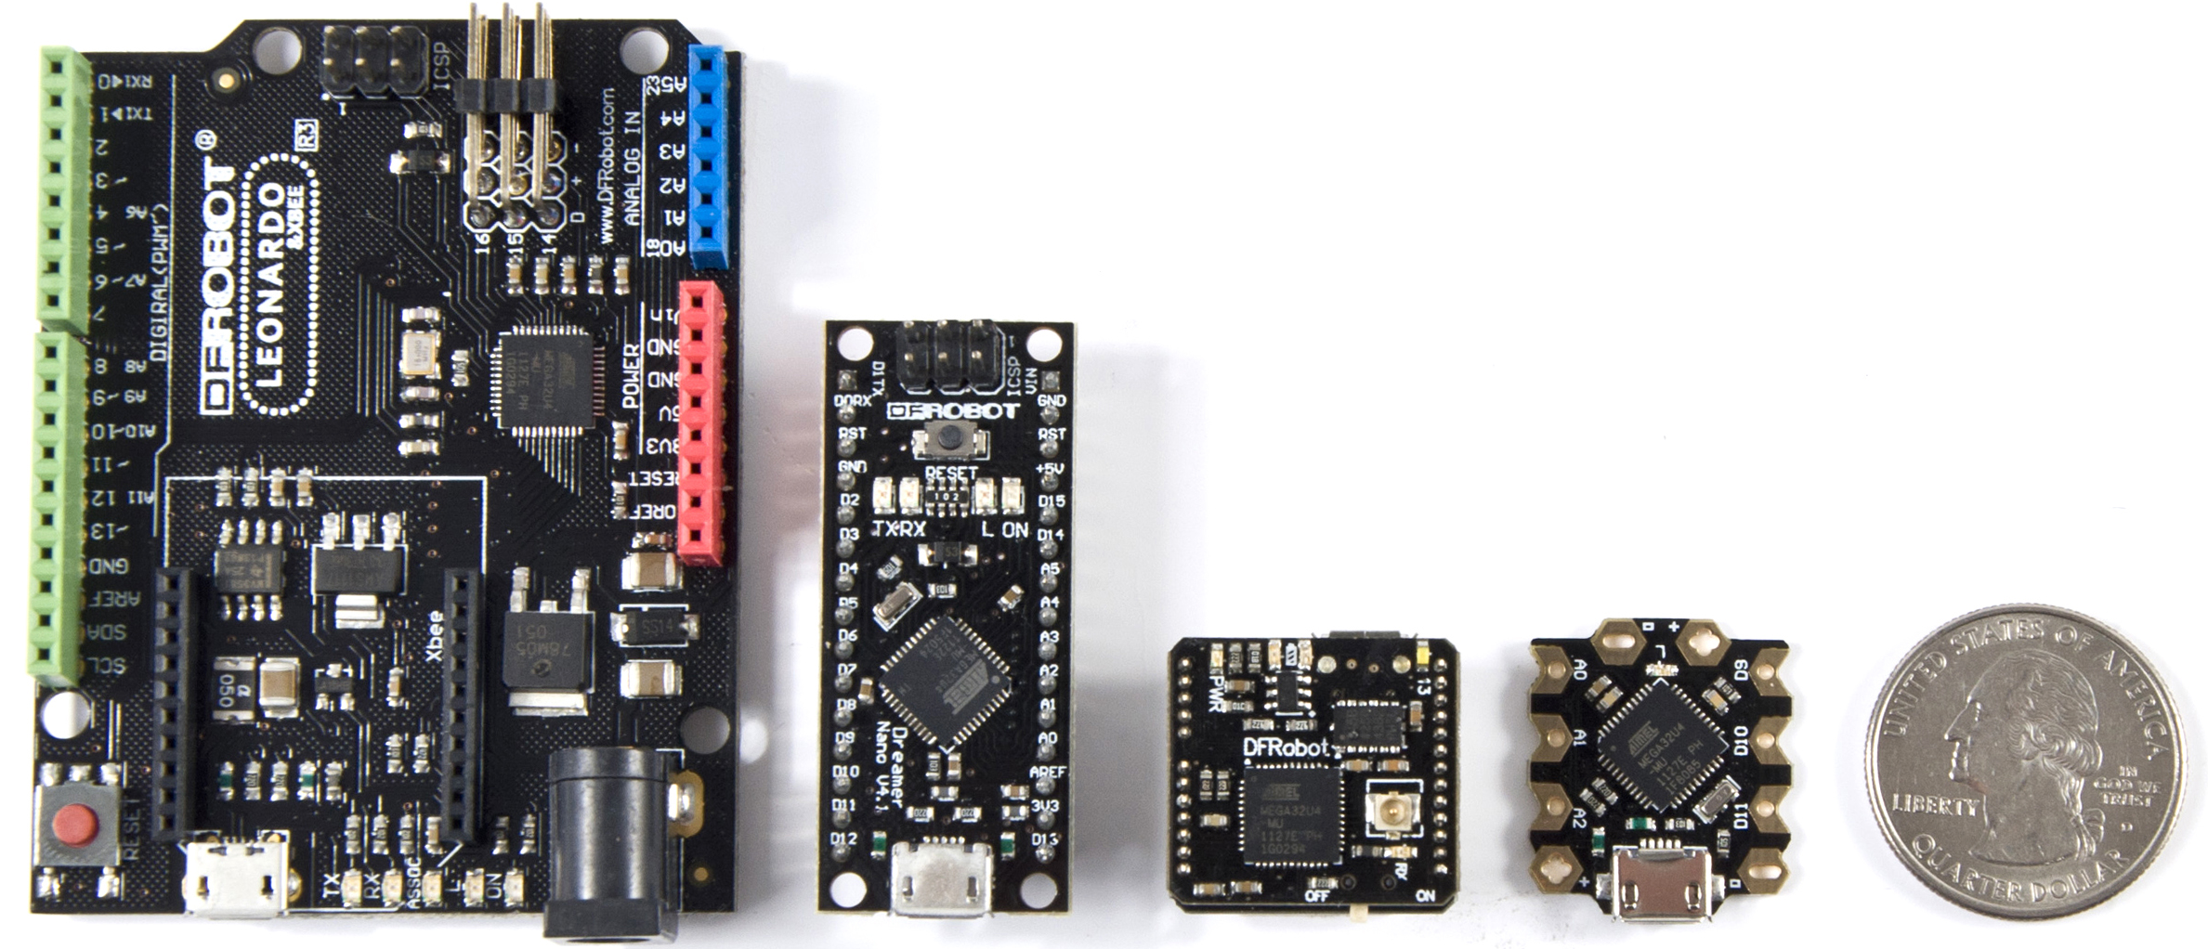
ML Model Training on MCUs
Our framework algorithms enables training ML models on such highly resource-constrained, ultra-low-cost, tiny devices
Edge2Train, Train++, ML-MCU are the proposed frameworks that contain novel algorithms to enable MCU-based IoT devices to continuously improve by learning from the fresh real-world data patterns seen after deployment
Edge2Train is baseline -> Train++ conserves memory + speedup training and inference -> ML-MCU is state-of-the art

Slide 9
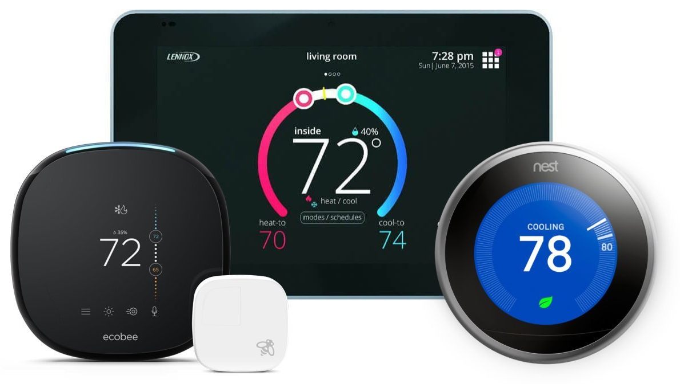
Use case 1: Self-learning HVACs
HVAC controllers are resource-constrained IoT edge devices. For example, Google Nest, Echobee, etc
Every building/infrastructure has differences. Standard/one-size-fits-all strategy fails to provide superior level of thermal comfort for people
Our algorithms can make HVAC controllers learn best strategy (offline) to perform tailored control of the HVAC unit for any building types
Eliminates the need to find and set distinct HVAC control strategies for each building
Our framework algorithms can create self-learning HVACs that can provide superior thermal comfort

Slide 10
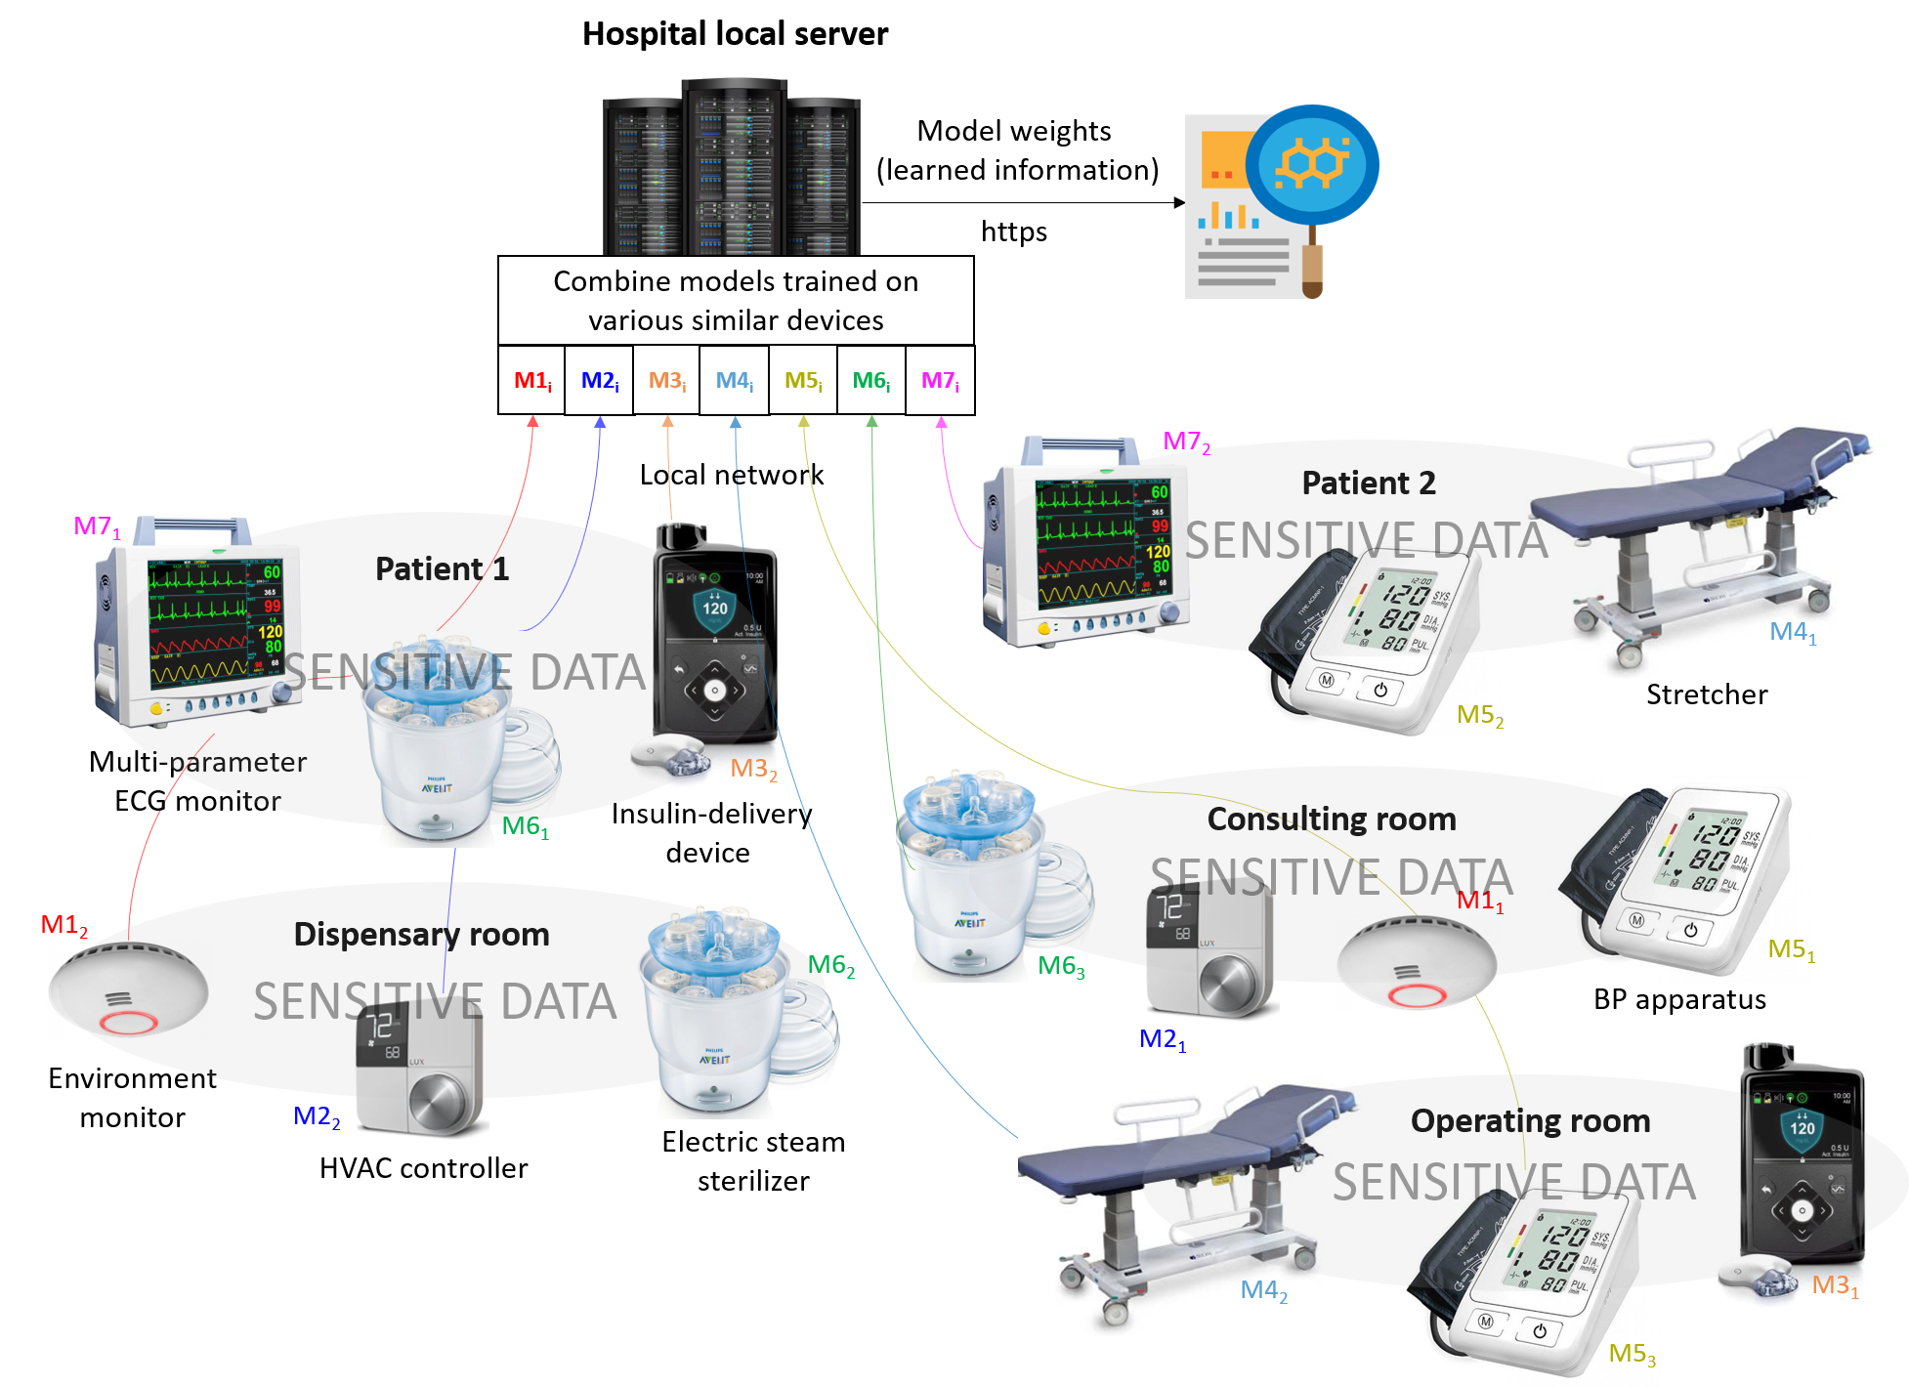
Use case 2: Sensitive Medical Data
Data required for most researches are sensitive in nature as it revolves around private individuals
Resource-constrained medical devices like insulin-delivery devices, electric steam sterilizers, BP apparatus, etc., can use our algorithms to train offline using the sensitive data
Transmit models instead of the actual medical data
Fuels fine element analysis at various stages of drug development, from identifying target molecules to recruiting patients for clinical trials
Enables manufacturers to know their device field performance, perform analysis for early warnings, etc
Our framework algorithms can be used to provide sensitive medical data for research

Slide 11
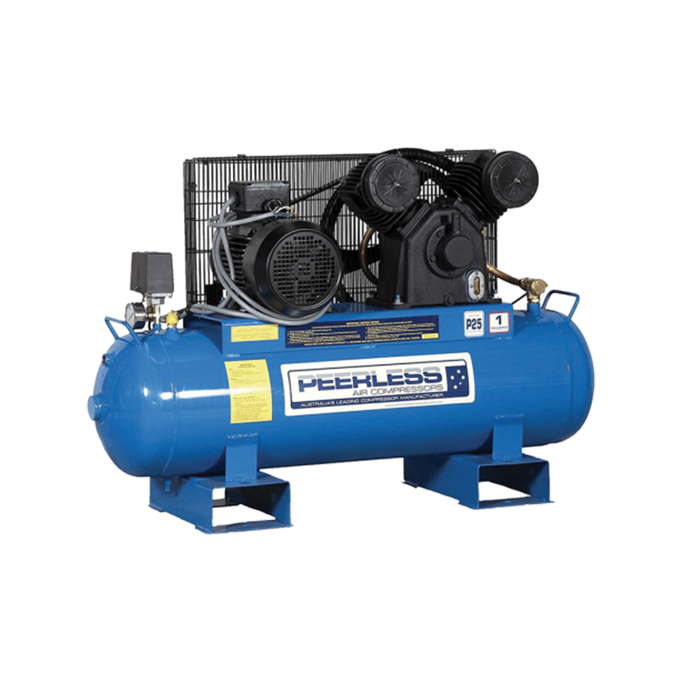
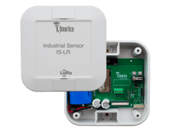


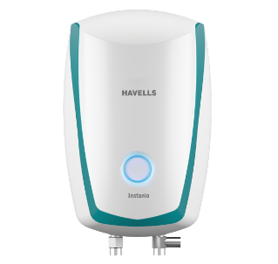
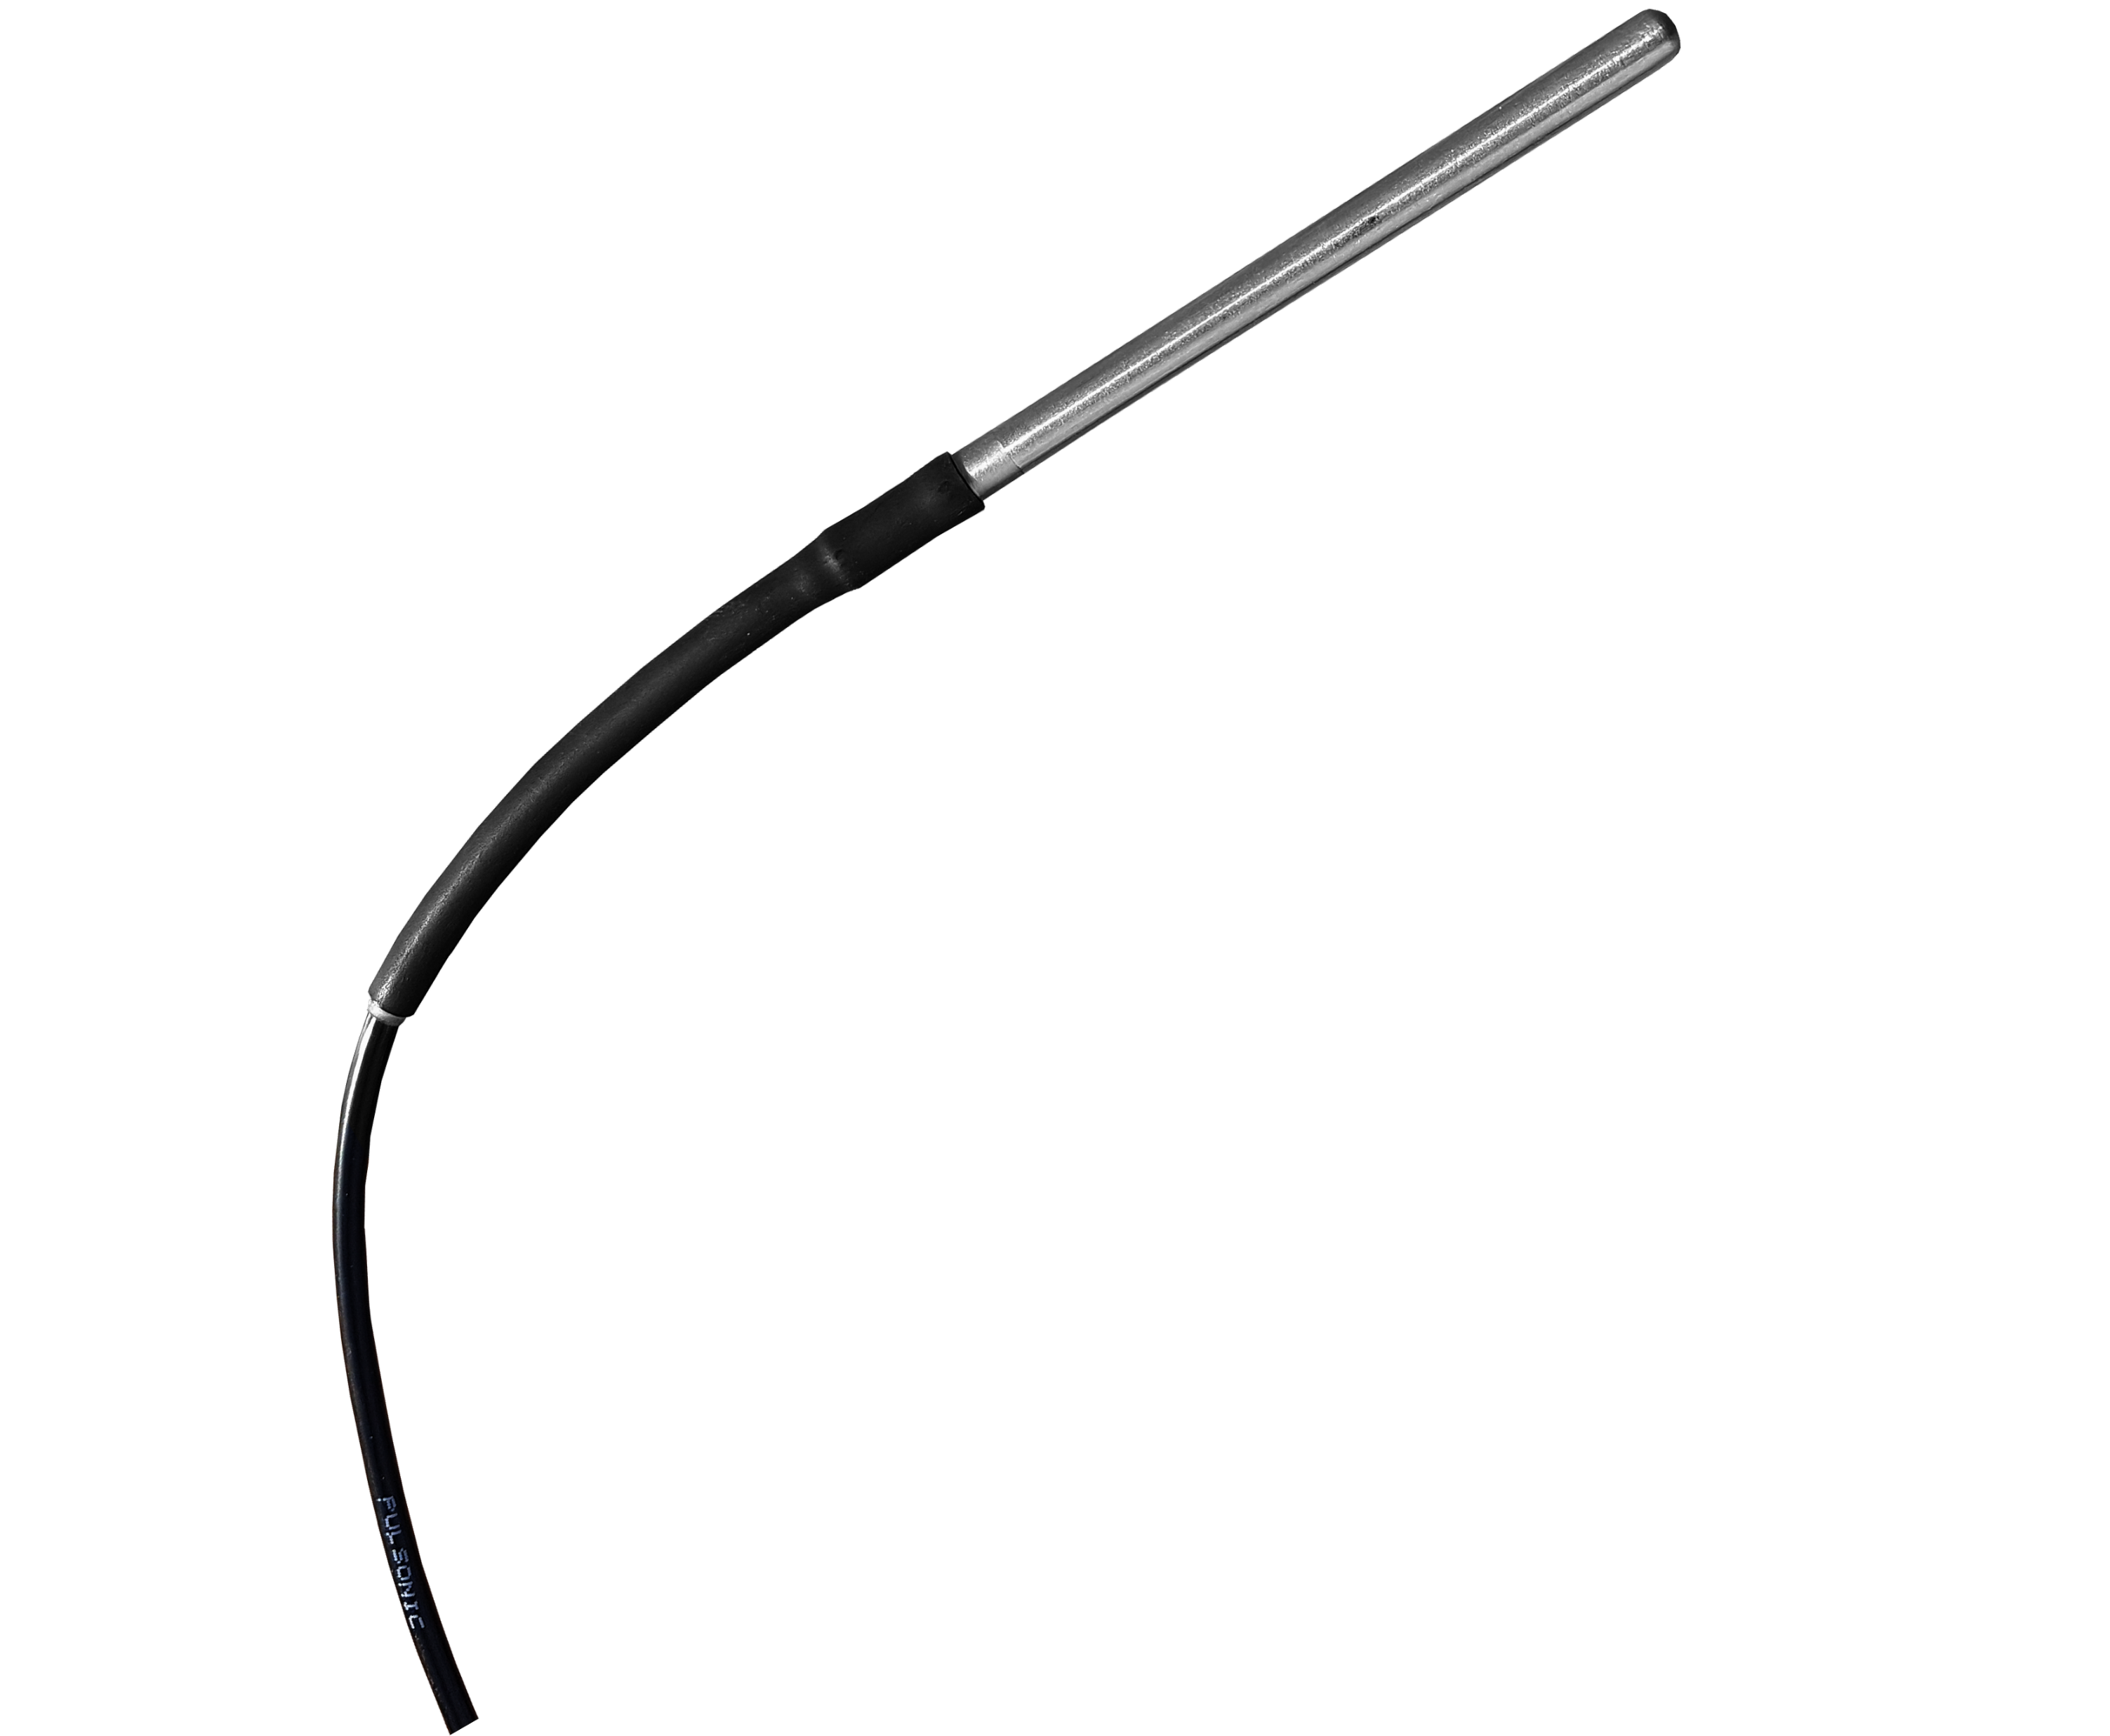
Use case 3: Learning any Patterns
Our framework algorithms can train models offline on MCUs. Thus, even the tiny IoT devices can self-learn data patterns
Learn usual residential electricity consumption patterns and raise alerts in the event of unusual usage or overconsumption. Thus we can reduce bills, detect leaks, etc
Learn by monitoring the contextual sensor data corresponding to regular vibration patterns from the pump's crosshead, cylinder and frame.
Generate alerts using the learned knowledge if anomaly patterns are predicted or detected
Use case: Learn to detect Leaks, monitor efficiency & consumptions
Train++
AI inside
Use case: Learn to monitor vibrations on pump's crosshead, cylinder and frame. Generate alerts if anomaly patterns are detected
Train++
AI inside
Self-learning the data patterns

Slide 12


Support Vector Machines (SVMs)
SVMs were chosen for training on MCUs because
Provides close to state-of-the-art accuracy, F1 score, ROC, etc. for various datasets
Theoretical foundations via generalization guarantees
Kernel tricks make SVMs robust, efficient even when data not linearly separable in feature space
From implementation angle Sequential Minimal Optimization (SMO) available for fast training
Compatibility when extending work to on-board multi-class settings: SVM based One-Vs-All (SVM-OVA), One-Vs-One (SVM-OVO), One Class classification (OC-SVM)
SVM Kernel trick
Notes:
https://arxiv.org/pdf/1703.00284.pdf

Slide 13
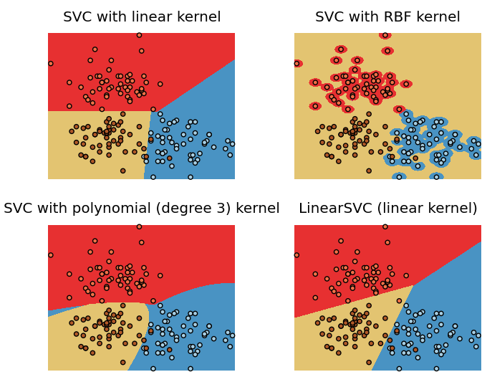
SVMs on IoT Devices
Challenges when executing SVMs on tiny IoT devices
With very high-dimensional feature spaces (e.g., text classification problem) intensive tuning is needed. RFs are starting to steal the crown here
Kernel SVMs are expensive in terms of time complexity and memory usage when the number of samples are large both at training and at testing time
SVMs need to be run using a grid search (specially in RBF case) over parameters like gamma and C: Not possible when training SVMs on IoT devices
SVC with RBF kernel: The entire area is classified to be yellow except the red and blue bits. In other words, there are too many support vectors
Notes:
https://arxiv.org/pdf/1703.00284.pdf
https://stackoverflow.com/questions/17794313/unexpected-results-when-using-scikit-learns-svm-classification-algorithm-rbf-k

Slide 14
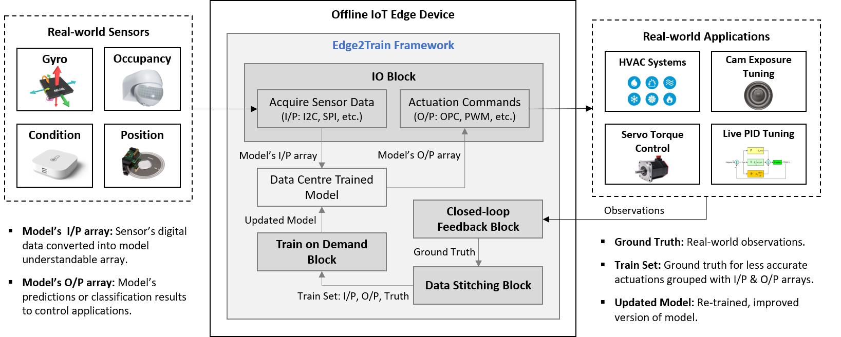
Edge2Train Framework
Architecture and components of Edge2Train: Training models on resource-scarce MCUs at the IoT edge
Edge2Train functions can enable training SVMs on MCUs using live data from their IoT use cases. Our functions also enable on-board inference and model evaluations
The blocks of our Edge2Train fuse with the device's IoT application to continuously improve edge analytic results by training using the evolving real-world data

Slide 15
Edge2Train Framework Components
The IoT applications deployed on edge devices follows a routine. In the background Edge2Train monitors this IoT application's routine using its blocks shown in previous Figure. The four blocks of Edge2Train are:
IO Block: Acquires sensor data using peripherals (I2C, SPI, etc.) and converts it to model understandable array. Generates actuation commands (OPC, PWM, etc.) to interact with real-world applications
Closed-Loop Feedback Block: Monitors the IoT application routine to compute feedback of each actuation. Provides ground truth by observing how accurately the IoT app controlled the real-world application
Data Stitching Block: Locally builds a dataset by stitching the model's input and output array for the unsatisfactory actuation with the ground truth from Closed-loop Feedback Block
Train-on-Demand Block: This block leverages our C++ Edge2Train library to set up, train and evaluate a new model, which is an update for the existing model

Slide 16
Edge2Train Functions
The five functions that constitute our C++ Edge2Train library are implementations of core algorithms. Available at: https://github.com/bharathsudharsan/Edge2Train
Fn1 - SVM Setup: Sets up parameters that tune the SVM
Fn2 - SVM Train: This function uses the local train sets to train SVMs on MCUs
Fn3 - SVM Infer: When sensor data is fed to this function, it calls the newly trained SVM, performs classifications, and sends results to the IoT application
Fn4 - SVM Eval: Evaluate the classification accuracy of the MCU-trained SVMs
Fn5 - Kernel: Produce implicit dot products of two values. On MCUs, it is used during training SVMs and while inferring using trained SVMs
Edge2Train
Fn1- SVM Setup
Fn2- SVM Train
Fn3- SVM Infer
Fn4- SVM Eval
Fn5- Kernel
Edge2Train Functions

Slide 17
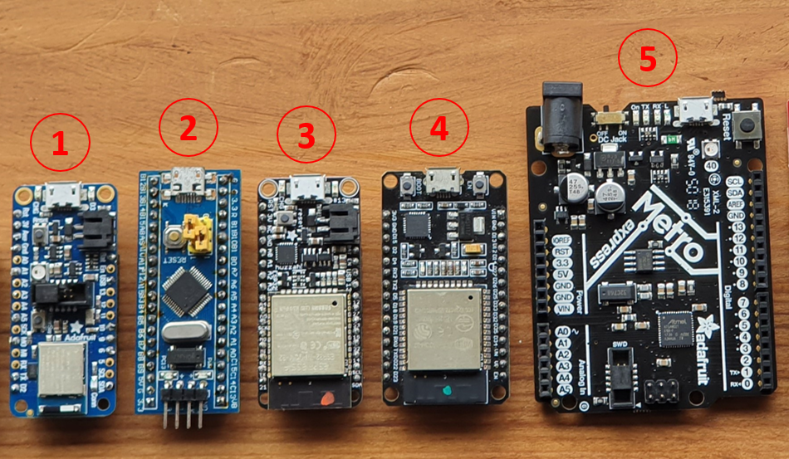
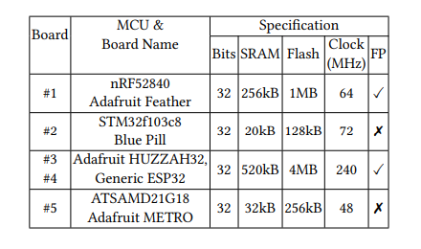
Edge2Train Evaluation Setup
Hardware: We evaluate Edge2Train by training SVMs on the shown MCU boards. Selected boards are
Popular, open source, globally available to purchase, low cost of 3 - 20 $, widely used by DIY communities, such MCUs are used to design IoT devices
Datasets: We used Iris flower (feature dimension of 4) and MNIST handwritten digits (feature dimension of 64)
Standard toy datasets widely used in ML community for initial algorithm evaluations
Comparison: After training we compare the accuracy, power consumed and inference time of our Edge2Trained models with Python Scikit learn models on high-resource CPUs
Popular open source MCU boards chosen to evaluate Edge2Train

Slide 18
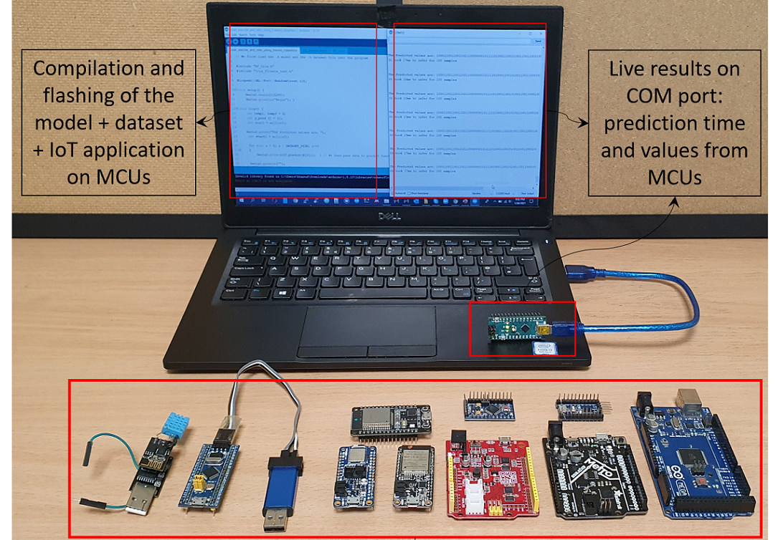
Edge2Train Evaluation Setup
We received the training and inference result from MCUs via Serial port. We report the following results, using which we perform analysis in the upcoming slides
Time and energy consumed to; Train SVMs on MCUs; Infer using thus trained SVMs on MCUs
Flash and SRAM consumed by Edge2Train on various MCU boards
Compare MCUs results (uses Edge2Train) with CPUs (uses Python scikit-learn) for the same datasets and tasks
Experiment setup: Onboard SVM training and inference using Edge2Train

Slide 19
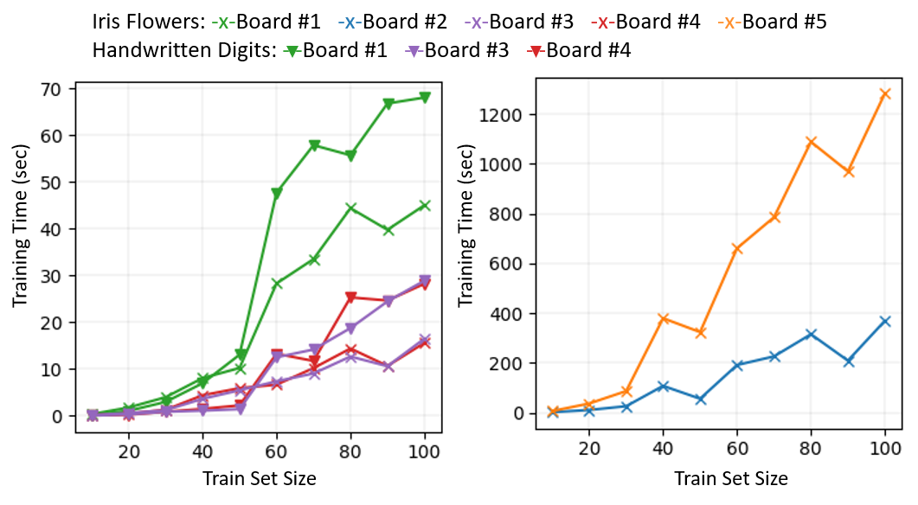
Results: SVMs Train Time on MCUs
The relationship between training time, training set size, and feature dimension
ESP32 took 15.58 secs to train for Iris. 28.24 secs for 64 features MNIST digits
Metro with 48 MHz clock and no FPS took 21.39 minutes for Iris (82x times slower than ESP32)
Training time grows swiftly with the number of training samples
Sudden peaks observed when Edge2Train consumes more time to find the optimal hyperplane
Trough points are observed when the optimal hyperplane is found quickly
MCU boards 1, 3, 4
MCU boards 2, 5
(Overflow for Digits)
Training SVMs on MCUs using Edge2Train: Comparing training set size (number of data rows) vs training time (sec)

Slide 20
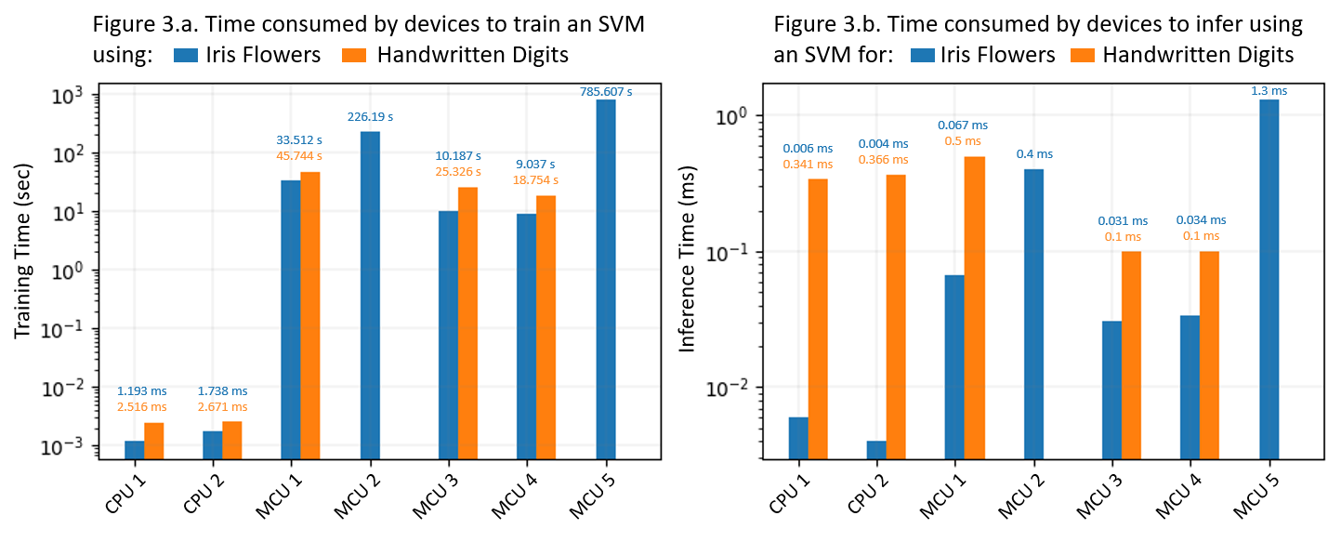
Results: Train Time Comparison
The chosen CPUs have 1000x better specifications over MCUs
The train time for all 5 MCUs and 2 CPUs are shown
CPU1 and MCU4 is fastest in their respective classes
CPU1 vs MCU4: CPU1 is only 7.57 sec faster than MCU4 for Iris and 7.45 sec for MNIST digits datasets
Although CPUs are faster, they cannot be used as edge devices due to their cost (CPU1 is 200x more costly than MCU4), form factor (5x more area), and energy consumption (7x times)
Since billions of edge devices are MCU-based, it is feasible to train even at lesser speeds. Models can rather be trained on the edge using our framework
Memory Overflow for Digits on MCU 2
Memory Overflow for Digits on MCU 5
Comparing training time on MCUs (uses Edge2Train) vs CPUs (uses Python scikit-learn)

Slide 21
Results: Infer Time Comparison
Performing inference on MCUs using the MCUs trained SVMs
The fastest MCU3 could infer in 0.0036 ms for Iris and 0.1 ms for Digits datasets
The fastest CPU2 performed the same tasks in 0.004 ms and 0.341 ms
MCU 3, 4 vs CPUs: MCUs 3, 4 that used our Edge2Train performed unit inference for the digits data (64 features) 3.5x times faster than CPUs
Inference time on MCUs is higher than state-of-the-art methods as we are executing full SVMs on MCUs
Memory Overflow for Digits on MCU 2
Memory Overflow for Digits on MCU 5
Comparing inference time on MCUs (uses Edge2Train) vs CPUs (uses Python scikit-learn)

Slide 22
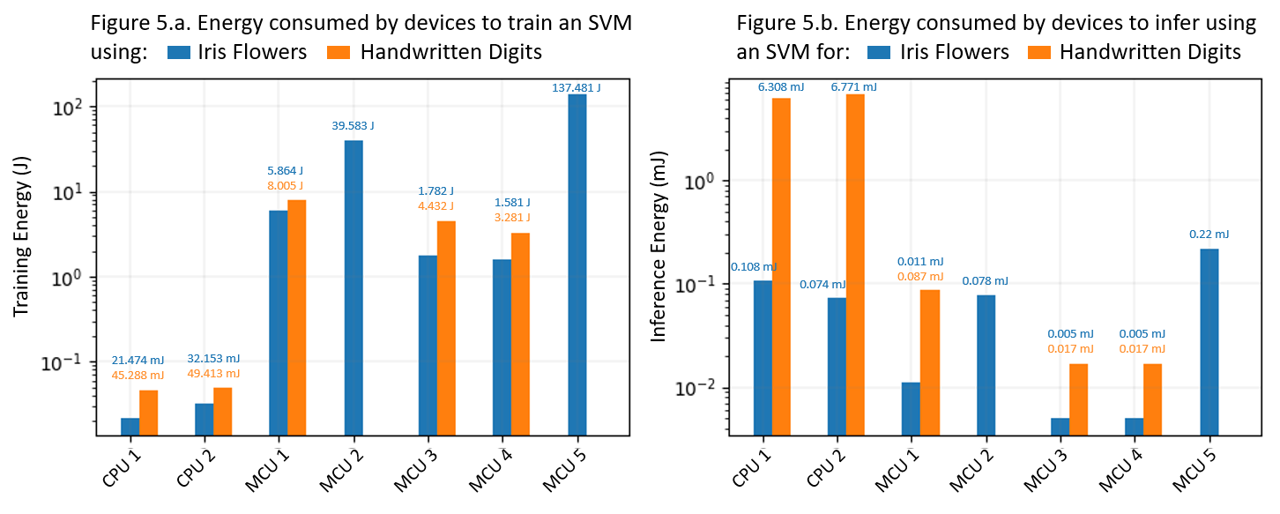
Results: Energy Efficiency
Memory Overflow for Digits on MCU 2
Memory Overflow for Digits on MCU 5
Memory Overflow for Digits on MCU 2
Memory Overflow for Digits on MCU 5
Comparing energy consumed on MCUs (uses Edge2Train) vs CPUs (uses Python scikit-learn)
Energy (in Joules) consumed to train and infer is calculated by multiplying the Current (Amperes) rating of MCUs with its Potential (Volts) and task time (seconds). For CPUs, we used the htop process viewer and powerstat tool
MCUs consume 20x times less energy for the Iris and 350x times less energy for digits than CPUs to unit infer
For unit infer using 64-dimension digits CPU1 consumed 58x more energy than to inference for a 4-dimension input. Whereas MCU4 only consumed 3.4x times more energy to infer for digits data than for Iris

Slide 23
Edge2Train Summary
We presented Edge2Train, a framework that enables a wide variety of open-source MCUs that have limited Flash, SRAM, and no FPS to re-train themselves locally and offline
MCU-based edge devices can now continuously improve themselves for better edge analytics results by managing to understand continuously evolving real-world data
The limitations of Edge2Train that need to be addressed are
Memory overflow issues on MCUs when input dataset is larger than flash memory. This is due to the non incremental loading characteristic of the algorithm
Model train time is very large on 8 and 16 bit MCUs

Slide 24


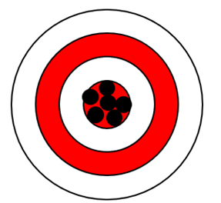

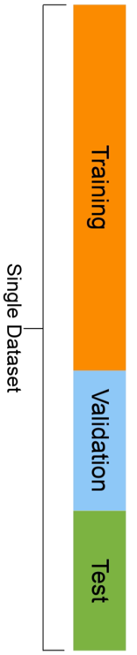
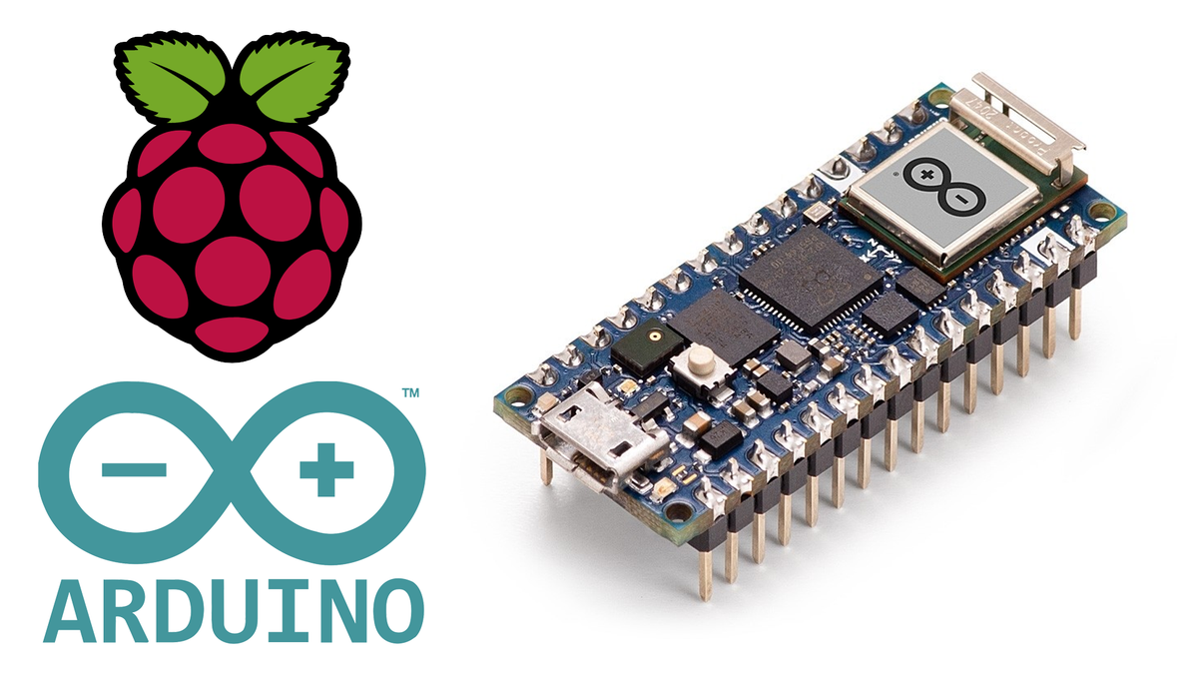
Train++ Incremental Training Algorithm
Learn from large datasets
Train++ is designed for MCUs to perform on-board binary classifier model training, inference. Train++ algorithm main highlights/benefits
Dataset size: Incremental training characteristic enables training on limited Flash and SRAM footprints while also allowing to use full n-samples of the high-dimensional datasets
Training speed and energy: Achieves significant energy conservations due to its high-performance characteristics i.e., it trained and inferred at much higher speeds than other methods
Performance: Train++ trained classifiers show classification accuracy close to those of Python scikit-learn trained classifiers on high-resource CPUs
Fast training and Inference
High Accuracy
and Precision
Significant energy conservation
Benefits of Training and Inference on MCUs using Train++
Notes:
https://www.reviewgeek.com/84390/new-arduino-nano-rp2040-connect-is-like-a-raspberry-pi-pico-on-steroids/

Slide 25

Train++: Pipeline
Four-steps to use our Train++ algorithm to enable the edge MCUs to self-train offline for any IoT use cases
Select any MCU of choice depending on the target use case
Contextual sensor data corresponding to normal working will be collected as the local dataset and used for training. The labels/ground truth for the collected training data rows shall be computed using our method from Edge2Train
The edge MCUs learns/trains using our core Train++ algorithm
The resultant MCU-trained models can start inference over previously unseen data
Train++ implementation available at https://github.com/bharathsudharsan/Train_plus_plus

Slide 26
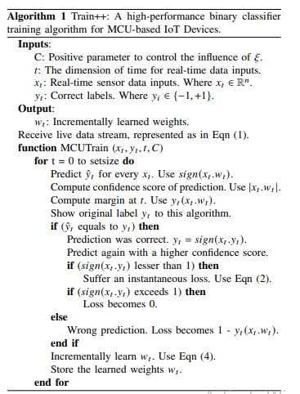
Train++: Core Algorithm
The full Train++ algorithm is shown. Algorithm characteristics
Highly resource-friendly and low complexity design
Implementation less than 100 lines in C++
Does not depend on external or third-party libraries
Executable even by 8-bit MCUs without FPU, KPU, APU support
Incremental data loading and training characteristics
Compatible with datasets that have high feature dimensions
Keeps reading live data -> incrementally learns from it -> discards data (no storing required)
In the next slides Train++ algorithm is split and explained in four parts

Slide 27
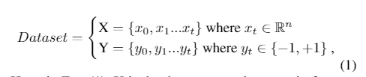
Train++: Core Algorithm
First part: Dataset, Inputs and Output for Train++
Input and output for the Train++ core algorithm. Eqn (1) is the local dataset that is based on the IoT use-case data
X is the dataset rows that contain features of input data samples
Y holds the corresponding labels
dimension of time (t) is considered indefinite as real-time sensor data keeps arriving with indefinite length

Slide 28
Train++: Core Algorithm
Initially the algorithm infers using a binary classification function that updates from round to round and the vector of weights w ∈ R ^{n} takes the sign (x . w) form
The magnitude |x . w| is the confidence score of prediction
w_{t} is the weight vector that Train++ uses on round t
y_{t} (x_{t} . w_{t}) is the margin obtained at t
Whenever algorithm makes a correct prediction sign (x_{t} . w_{t}) = y_{t}
After prediction, we instruct Train++ to predict again with a higher confidence score
Hence, the goal becomes to achieve at least 1 as the margin, as frequently as possible
Second part

Slide 29
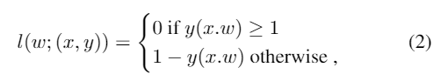
Train++: Core Algorithm
Whenever y_{t} (x_{t} . w_{t}) < 1 Hinge-loss makes Train++ suffer an instantaneous loss
If margin exceeds 1 the loss is zero
Else, it is the difference between the margin and 1
Now we require an update rule to modify the weight vector for each round
Third part

Slide 30
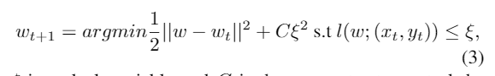
Train++: Core Algorithm
Update rule to modify the weight vector for each round. ξ is a slack variable, C is the parameter to control influence of ξ
Whenever a correct prediction occurs, the loss function is 0
The argmin is wt, hence Train++ algorithm becomes permissive
Whereas on the rounds when misclassifications occur, loss is positive and Train++ offensively forces w_{t+1} to satisfy the constrain l (w; (x_{t} , y_{t})) = 0
Larger C values produce strong offensiveness, which might increase the risk of destabilization when input data is noisy
Lower C values improve adaptiveness
Fourth part

Slide 31
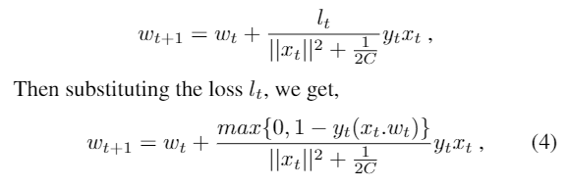
Train++: Core Algorithm
To keep w_{t+1} close to w_{t}, to retain the information learned in previous rounds. The update rule in its simple closed-form is w_{t} + τ_{t} y_{t} x_{t}. Substituting τ then substituting loss l_{t} we get Eqn (4)
This update rule meets our expectations since the weight vector is updated with a value whose sign is determined by y_{t} (magnitude proportional to error)
During correct classification, the nominator of Eqn (4) becomes 0, so w_{t+1} = w_{t}
During misclassification the value of the weight vector will move towards x_{t}
After this movement, the dot product in the update rule becomes negative. Hence input is classified correctly as +1
Fourth part

Slide 32
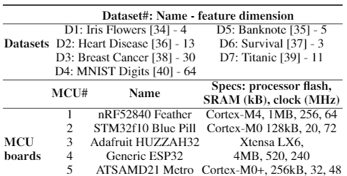
Train++ Evaluation Setup
Datasets and MCUs used for Train++ evaluation
Using Train++, for datasets D1-D4, we train a binary classifier on MCUs 1-5. This multiple datasets and MCUs based extensive experimental evaluation aims to answer
Is Train++ compatible with different MCU boards, and can it train ML models on MCUs using various datasets with various feature dimensions and sizes?
Can Train++ load, train, and infer using high features and size datasets on limited memory MCU boards that have low hardware specification and no FPU, APU, KPU support?

Slide 33
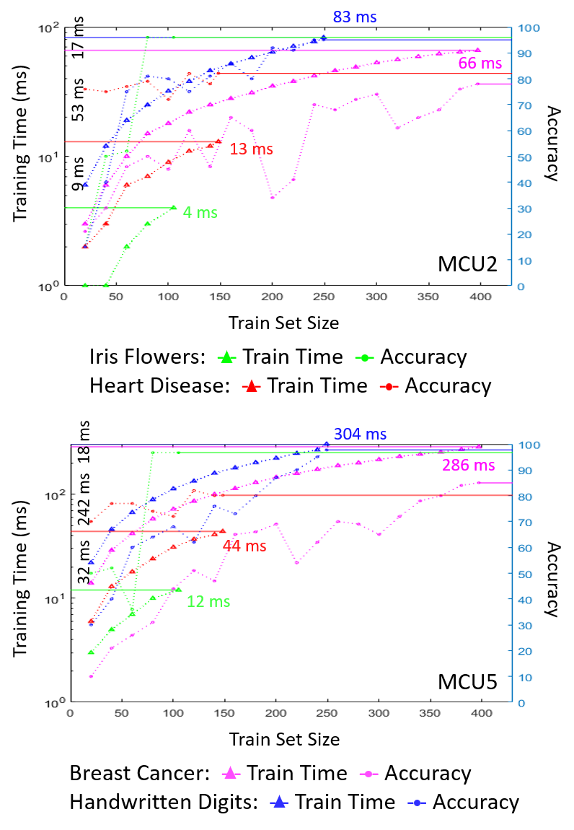
Results: Train Time
Training models on MCUs using Train++: Comparing training set size vs training time and accuracy for selected datasets
We show results only for MCUs 2, 5 as other MCUs trained in 2 ms
The gap in y-axis is difference in train time between datasets
Train time grows almost linearly with samples for all datasets
For the Iris dataset MCU2 only took 4 ms to train on 105 samples
It took 83 ms to train on the Digits dataset
MCU5 is slowest since it only has a 48 MHz clock, does not have FPU support. Hence it took 12 ms to train on 105 samples of the Iris dataset (3x times slower than MCU2) and 304 ms to train on the Digits dataset (3.6x times slower than MCU2).

Slide 34
Results: Infer Time and Memory
Memory: Flash and SRAM consumption is calculated during compilation by the IDE
For MCU1, Iris dataset and Train++ in total used only 4.1 % of Flash and 3.4 % SRAM. For Digits, the same MCU1 requires 6.54 % and 29.93 %
When using Edge2Train, for MCUs 2, 5, we cannot train using the Digits dataset because SRAM overflowed by +52.0 kB and +63.62 kB. Similarly for Heart Disease both the Flash and SRAM requirements exceed the MCU's capacity
Even after overflow on MCU2, Train++ incremental training characteristics could load the dataset incrementally and complete training in 83 ms
Similarly, even after overflow on MCU5, Train++ was able to load the entire dataset incrementally and train in 304 ms
Inference time: For the selected datasets, on MCUs 1-5, Train++ method infer for the entire test set in lesser time than the Edge2Train model's unit inference time

Slide 35
Results: Accuracy
Accuracy: The highest onboard classification accuracy is 97.33 % for the Iris (D1), 82.08 % for Heart Disease (D2), 85.0 % for Breast Cancer (D3), 98.0 % for Digits dataset (D4)
Accuracy comparison: When comparing the accuracy of Train++ trained models with Edge2Train trained models
For the same Iris dataset, the accuracy improved by 7.3% and by 5.15% for the Digits dataset. This improvement is because our training algorithm enabled incremental loading of the full dataset
Other algorithms like SVMs work in batch mode, requiring full training data to be available in the limited MCU memory, thus sets an upper bound on the train set size
Train++ trained models achieved overall improved accuracy compared to the Edge2Train models, which were trained with limited data (unable to load full dataset due to memory constraints)

Slide 36
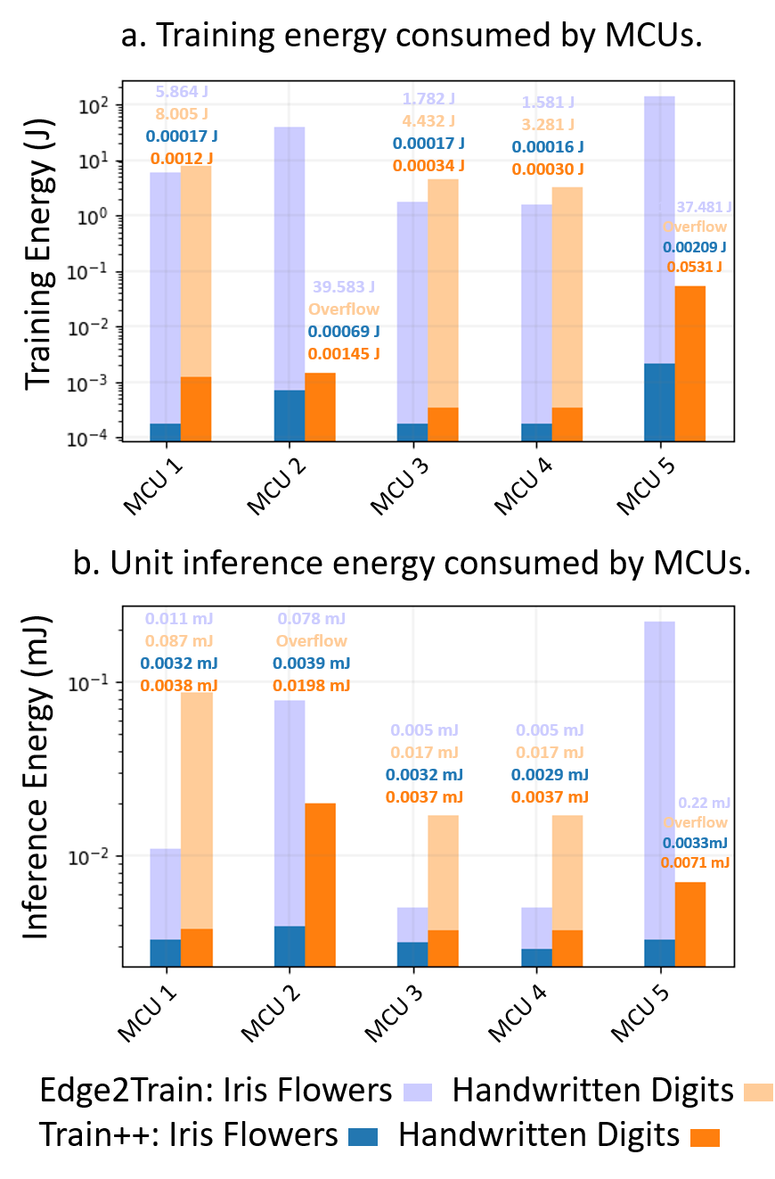
Results: Edge2Train vs Train++
From the shown Figure (y-axis in base-10 log scale) it is apparent that Train++ consumed
34000 - 65000x times less energy to train
34 - 66x times less energy for unit inference
For a given task that needs to be completed by using the same datasets on the same MCUs, Train++ achieved such significant energy conservations due to its high-performance characteristics (i.e., it trained and inferred at much higher speeds)
When Train++ is used, MCUs can perform onboard model training and inference at the lowest power costs, thus enabling offline learning and model inference without affecting the IoT edge application routine and operating time of battery-powered devices
Edge2Train vs Train++

Slide 37
Train++ Summary
The summary of Train++ benefits are
The proposed method reduces the onboard binary classifier training time by ≈ 10 - 226 sec across various commodity MCUs
Train++ can infer on MCUs for the entire test set in real-time of 1 ms
The accuracy improved by 5.15 - 7.3 % since the incremental characteristic of Train++ enabled loading of full n-samples of high-dimensional datasets even on MCUs with only a few hundred kBs of memory
Train++ is compatible with various MCU boards and multiple datasets
Across various MCUs, Train++ consumed ≈ 34000 - 65000x times less energy to train and consumed ≈ 34 - 66x times less energy for unit inference

Slide 38
Train++ Summary
The majority of real-world IoT use cases generate multi-class data
Health monitoring, gesture recognition, equipment condition monitoring, etc
Training multi-class classifiers on MCUs using any existing methods are not feasible since the computation demands of training process exceeds the hardware resource of MCUs
Still need for a resource-friendly algorithm to enable training multi-class classifiers (to distinguish from multiple possible outcomes) directly on MCUs

Slide 39
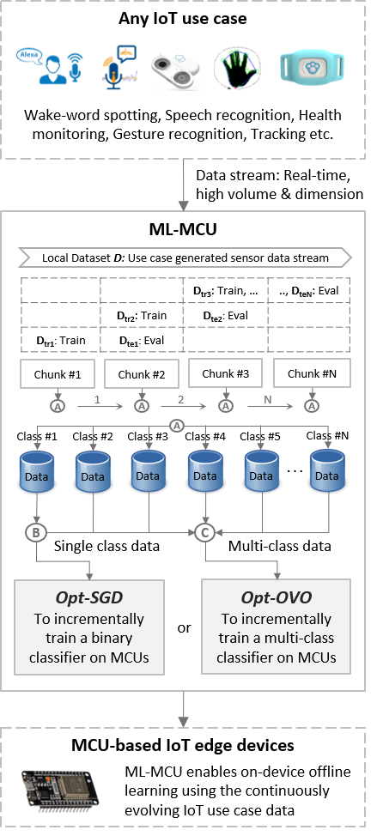
ML-MCU Framework
Novelty: Opt-SGD and Opt-OVO algorithms
Optimized-Stochastic Gradient Descent (Opt-SGD): To enable high performance, resource-friendly binary classifiers training on small edge MCUs. This method combines benefits from both Gradient Descent (GD) and Stochastic Gradient Descent (SGD) thus, inheriting the stability of GD while retaining the work-efficiency of SGD
Optimized One-Versus-One (Opt-OVO): To the best of our knowledge, this is the first novel algorithm to enable multi-class classifiers training on MCUs. Our Opt-OVO archives reduced computation by identifying and removing base classifiers that lack significant contributions to the overall multi-class classification result

Slide 40
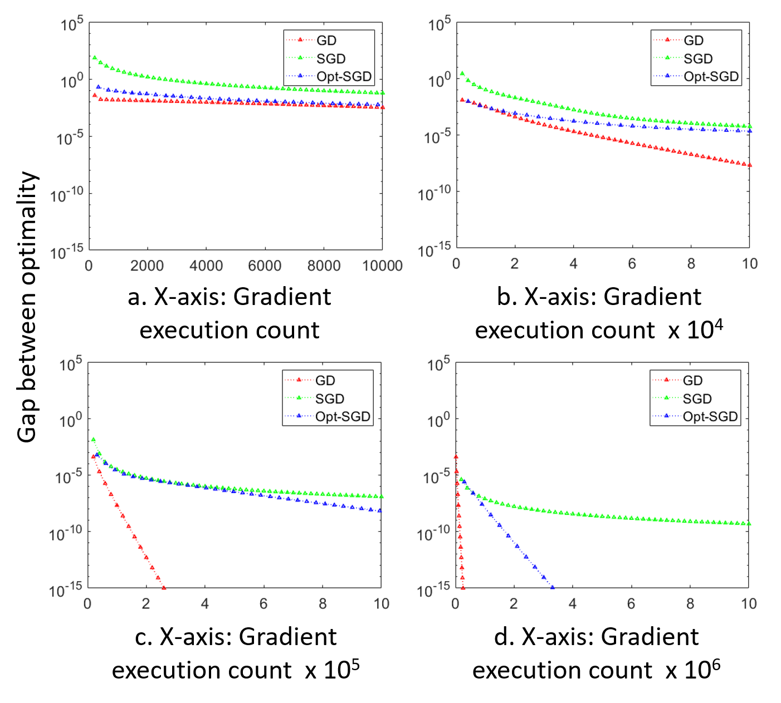
ML-MCU Results: Convergence
Comparing convergence behavior of Opt-SGD with GD, SGD
The convergence of GD and Opt-SGD is linear. SGD shows sub-linear pattern
As the data increases, inefficiency of GD increases since to update the model weights for each iteration, the algorithm needs to pass through the entire dataset
The convergence of SGD is very slow, whereas our Opt-SGD was capable to reach high precision despite its stochastic characteristic
For a very large train set, our method is less efficient than SGD. But practically we don’t train using large data on MCUs, anyways ML-MCU framework initially splits the data stream into data chunks that are small, for which our algorithm performs better than GD (higher precision) and faster than SGD

Slide 41
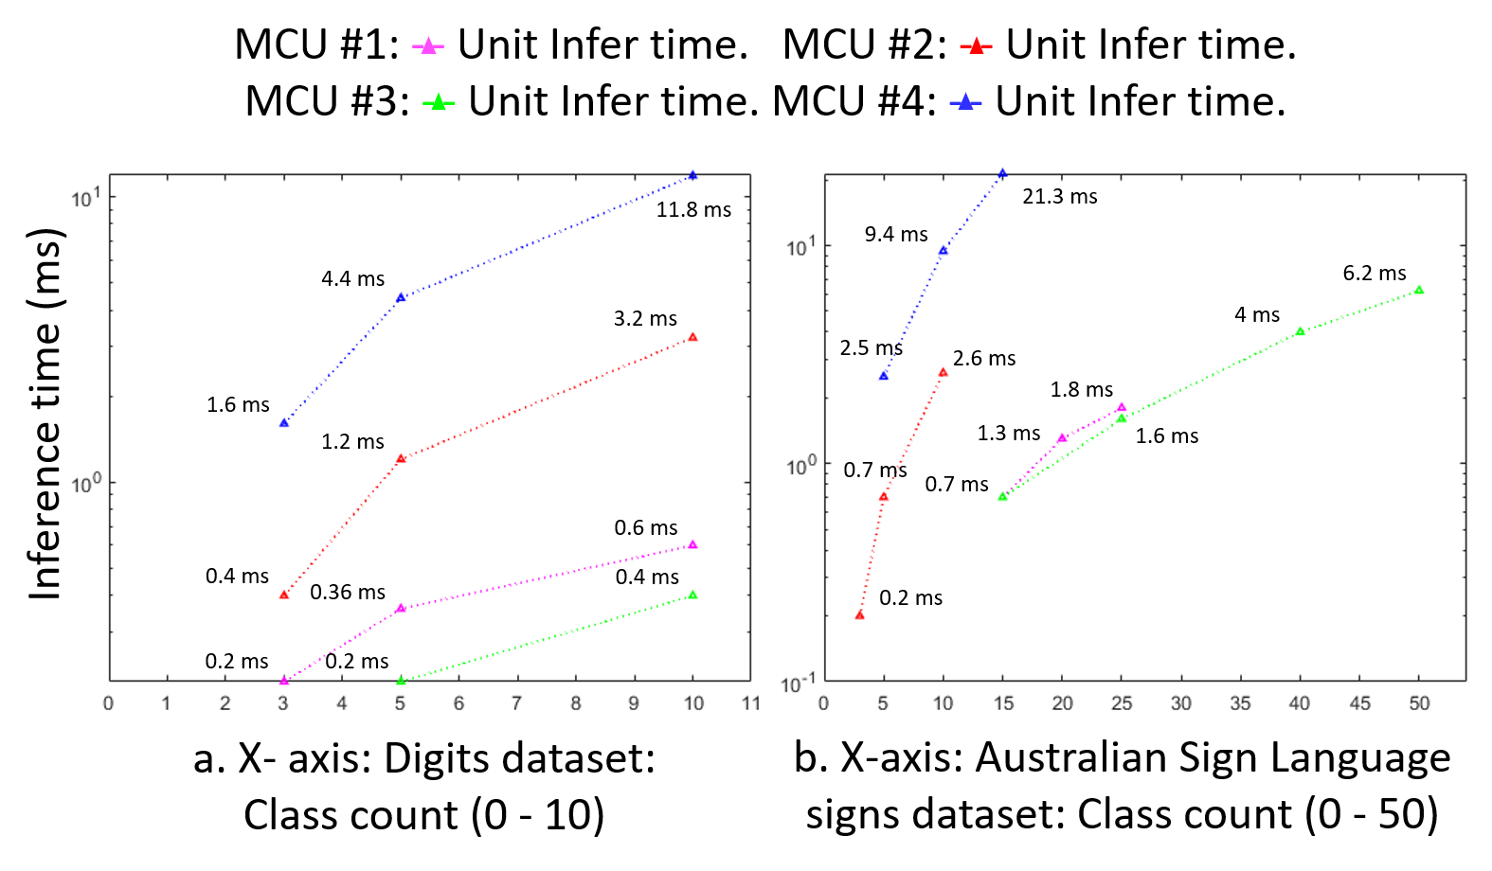
ML-MCU Results: Infer Time
Real-time unit inference in 11.8 ms, even on the slowest MCU4
The fastest MCU3 was able to infer for a 50 class input in 6.2 ms
Overall, it is apparent that our Opt-OVO trained classifiers perform onboard unit inference for multi-class data in super real-time, within a second, across various MCUs
Inferring for multi-class data on MCUs: Class size (3 to 50) vs inference time of the onboard Opt-OVO trained classifiers

Slide 42
Conclusion
We briefly presented
Edge2Train to enable onboard resource-friendly training of SVM models
Train++ for ultra-fast incremental onboard classifier training and inference
ML-MCU to train up to 50 class ML classifiers on a $ 3 device ESP32 MCU board
These algorithms enable a wide variety of open-source MCUs that have limited Flash, SRAM, and no floating-point support to re-train themselves locally and offline

Slide 43



Contact: Bharath Sudharsan
Email: bharath.sudharsan@insight-centre.org
www.confirm.ie
Notes:
If you have any further queries you can contact us anytime.
Thank you, stay safe.

